Slide 1

AAD Final Interaction
Team AP

Slide 2
Agenda
Accomplishments
Incorporation of Feedback
Extras
Brief Overview (Part-wise)
Learning
Key Takeaways

Slide 3
Accomplishments
Discussing and Ideating
Writing the novel
Proof reading

Slide 4
Incorporation of Feedback
Added conversations between mentors
Added conversations between algorithms
Added communication between external people and algorithms.
Considered the hardware aspect by ensuring a level playing field for all algorithms.

Slide 5
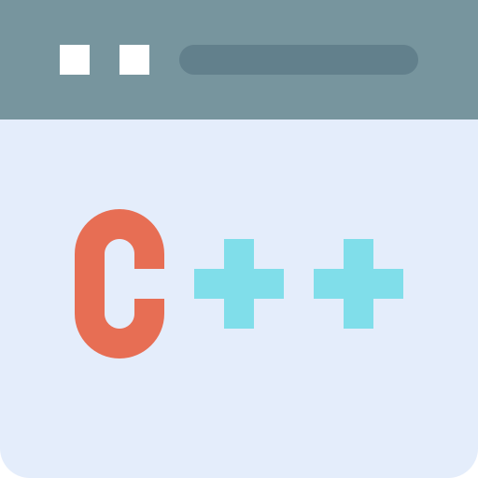



Extras
Code Implementation
Aesthetic Elements
Character Images
Playlist

Slide 6
Brief Overview
The Algorhythm Games are an annual tradition in the Central Processing Unit, conducted in the Control Unit, the capital of this fictional universe.
President Alan Turing, Chief Executive Lady Ada Lovelace and Vice-President Charles Babbage facilitate the Games. They choose a problem, and select 4 algorithms to compete in the Games.
The algorithms are humanoid robots, mentored by their creators. They are judged by time, speed and randomness optimization.
The best performer wins, with the underlying message that the best can always get better.
The story begins at the 4th Algorhythm Games, where during the announcement, a mother narrates the stories of the previous Games to her daughter.
The previous 3 years were divided among the three members of the project. Considerable creative liberty was taken in all three stages by their respective authors.

Slide 7
Brief Overview – Part 1
Algorithms participating are Bubble Sort, Quicksort, Merge Sort and Heap Sort. Their mentors are their inventors.
The algorithms are faced with three rounds to determine the best sorting method.
The rounds involve sorting actual objects based on a parameter as well as numerical data.
Through discussion with their mentors, the algorithms occasionally find ways to improve their performance.
Time and space usage are tested, and the algorithm with best performance in both regards wins.

Slide 8
Brief Overview – Part 2
The algorithms are asked to construct a tower with the answer on top. They are given blocks of hardware which they must use to construct the tower.
The tower built in the fastest time, using the fewest blocks, in the most stable manner is the winner for that round. This tests for time, space and randomness optimization respectively.
(SPOILER ALERT) The algorithms all demonstrate some form of improvement.
The iterative method is unable to handle negative numbers or erroneous numbers so it is disqualified in the first round.
The recursive algorithm evolves to use dynamic programming.
The Binet algorithm uses binary exponentiation to increase efficiency.
The matrix exponentiation algorithm evolves to fast doubling.

Slide 9
Brief Overview – Part 3
Four algorithms enter a race which is 3 days long and has 5 levels
The algorithm to complete maximum number of levels wins the competition * They are tested on time and space complexities
Level 1 - find the shortest path in a directed graph
Level 2 - find the shortest path in an undirected graph
Level 3 - find the shortest path with negative edges
Level 4 - detect negative cycles
Level 5 - find the shortest path in the presence of negative cycles

Slide 10




Learning
Learning from self by thinking about ways to include algorithms in the story, and ways to show their gradual improvement.
Learning from people such as Professor and TAs through lectures, tutorials and regular interactions about the project.
Learning from online resources about the inventors of algorithms and clarifying the implementation for maximal accuracy.
Learning from peers by discussing ways to improve the story by addition of innovative ideas and different perspectives.

Slide 11
Key Takeaways
This project gave us the opportunity to further our learning on two avenues – algorithm design and the literary arts.
We were able to analyse each algorithm and ascertain how exactly it functions and opportunities for optimization.
We were able to judge the merits and demerits of different approaches to the same problem, while gaining appreciation for how wide the scope of problem solving truly is.
We also learnt about writing a book, setting goals and achieving them (to some extent).
The concept of thinking deeply about ways to incorporate computational ideas into a believable fictional universe was a fun experience.
The best part was getting to apply theoretical concepts learned in college and turn them into an aspect of a book in a realistic way.

Slide 12


